Slide 1

ONLINE BANKING
226 JAVA (SL – NG) RLL GROUP-5

Slide 2

Team leader: OGGU DINESH KUMAR REDDY
TEAM MEMBERS : MONISHA
MORLA SAHITHI
BOOBALAN
SHANMUGA PRIYA
NANABALA SREENATH
NIVETHA KAMALAKKANNAN
NUNE JAHNA TEJASWI
OTTIKUNTA SAHITH
PRASANTH SUNDARRAJAN

Slide 3

CONTENTS
Technologies Used
Problem Statement
Objective
The Proposed System
Modules
System Architecture
Sequence Diagram
Database
Flowchart
Output
Testing
Conclusion & Goals

Slide 4




TECHNOLOGIES USED
Front-end :Angular
Back-end: SpringBoot
Programming Language :Java
IDE/Workbench :MyEclipse6.0
Database : MySQL
Server Deployment :Tomcat 9.x

Slide 5
PROBLEM STATEMENT
Online Bank Management System is a very simple and entry level project developed in java using spring boot and angular.
Here, A Database is used to store all the details of customer account in a table.
This system is a simple project and useful for those who want to learn Java fsd.
Users can login, do withdrawal, Request a Deposit amount, Transfer amount from one account to another account, check his/her current balance, and view reports of all the transactions.

Slide 6

OBJECTIVES
The Main Objective of Online Banking by commercial enterprise has been in existence much greater in number due to lower operating costs is associated .
Online Banking has been in the form of automatic teller machines and telephone transactions.
It has been transformed by the Internet, a new delivery channel for banking services that benefits both customers and banks.

Slide 7
IMPLEMENTATION:
ANGULAR IMPLEMENTATION: Angular is used to develop the frontend application. As a framework, Angular has clear advantages while also providing a standard structure for developers to work with. Angular is a frontend framework that allows developers to write once and deploy to multiple platforms. SPRINGBOOT IMPLEMENTATION: Springboot is used perform the backend application. It is used to develop the API and operations like add, update, delete and view and connecting to MYSQL database.

Slide 8
THE PROPOSED SYSTEM
The development of this new system contains the following activities,
Customer must have a User- Id, password and Account Number to login to the system.
The System provides the all bank operations like deposit, withdraw, and funds transfer between the two accounts.
The System providing the fully secured login features.

Slide 9
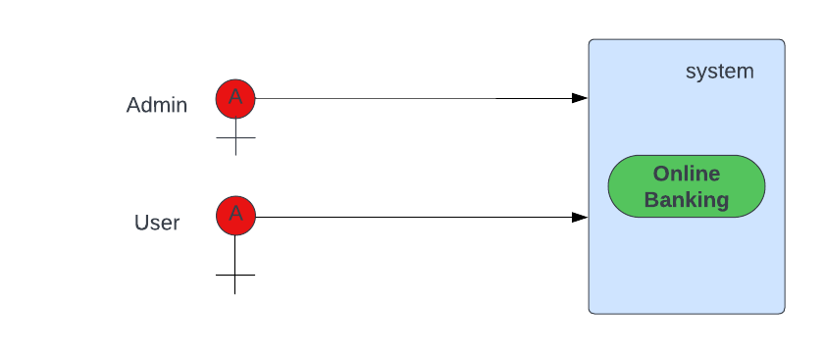
Use Case Diagram

Slide 10

MODULES
The Modules involved are
Administrator
Customer
Security and authentication

Slide 11


Module CONTD…
ADMIN MODULE:
The Admin Can View the Users
The Admin Approve the Cheque Book Requests
The administrator can also lock the user accounts

Slide 12
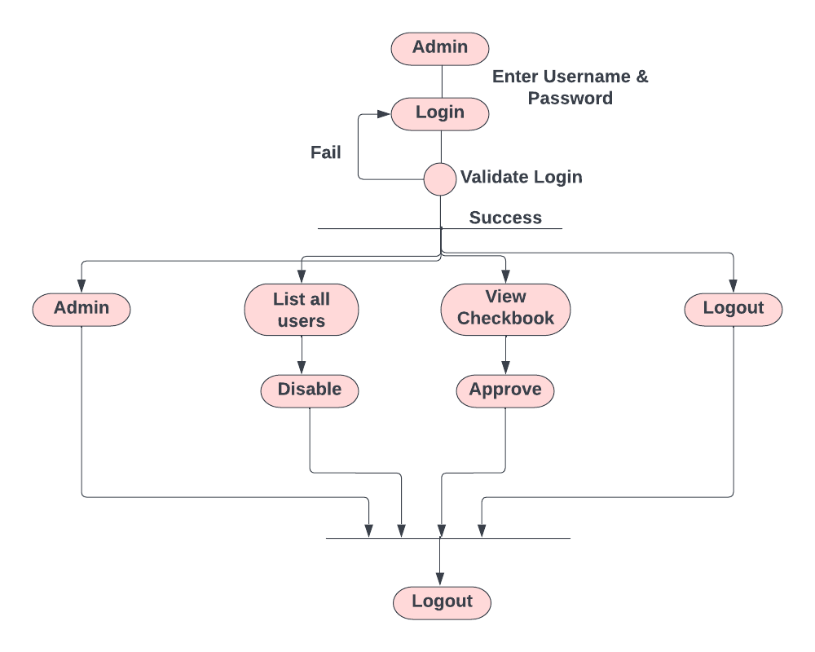
Admin Activity Diagram

Slide 13
MODULE CONTD... USER-module:
Register or Login to the Application
Deposit and Withdraw Money from the Account
View the Balance in Primary and Savings Account
Chequebook Requests for Different Accounts
User can do the Transaction.

Slide 14
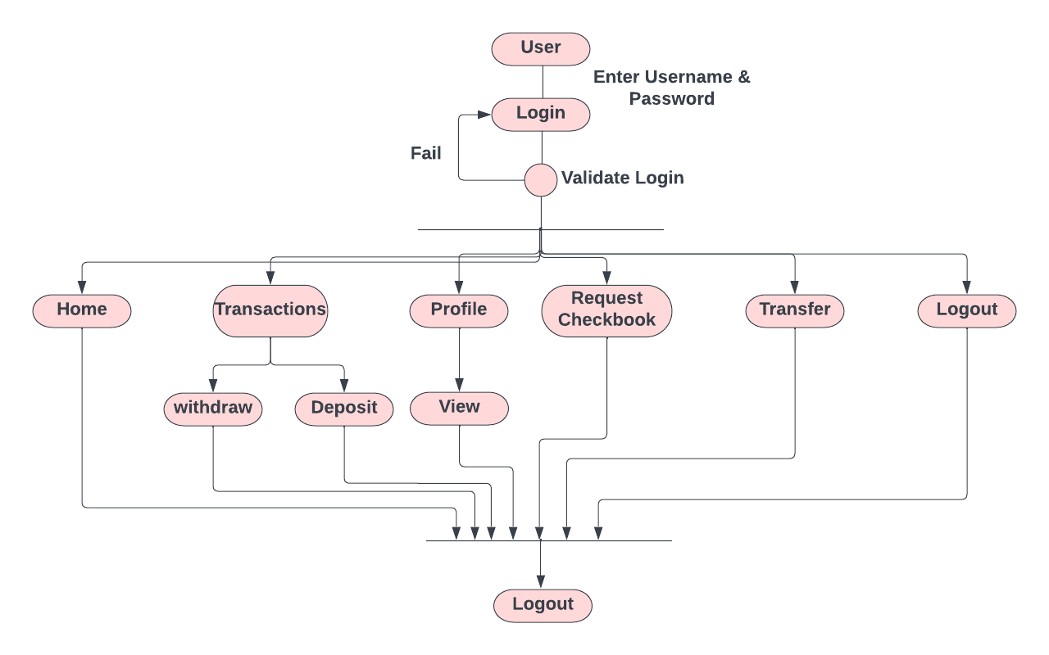
User Activity Diagram

Slide 15

MODULE CONTD…
SECURITY AND AUTHENTICATION MODULE:
The user details should be verified against the details in the user tables .
If it is valid user, they should be entered into the system.
Once entered, based on the user type access to the different modules to be enabled / disabled.

Slide 16
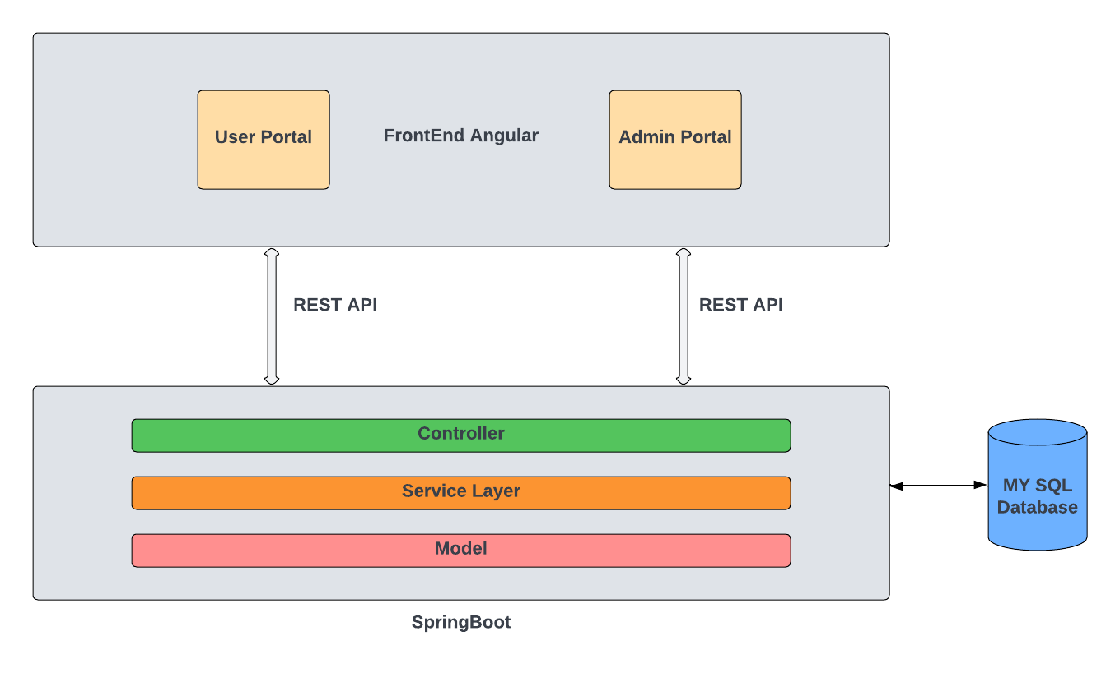
SYSTEM ARCHITECTURE

Slide 17
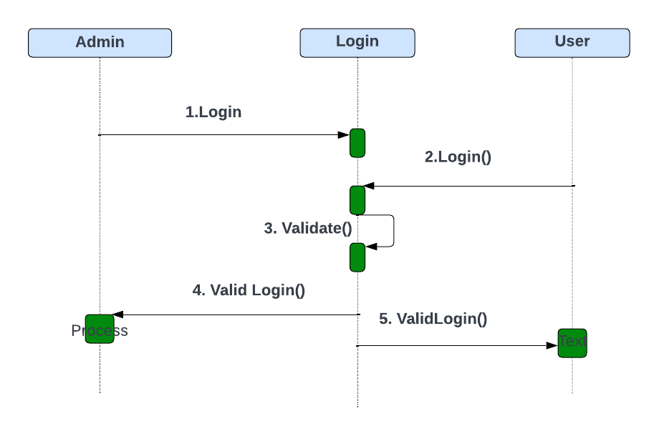
LOGIN SEQUENCE DIAGRAM

Slide 18
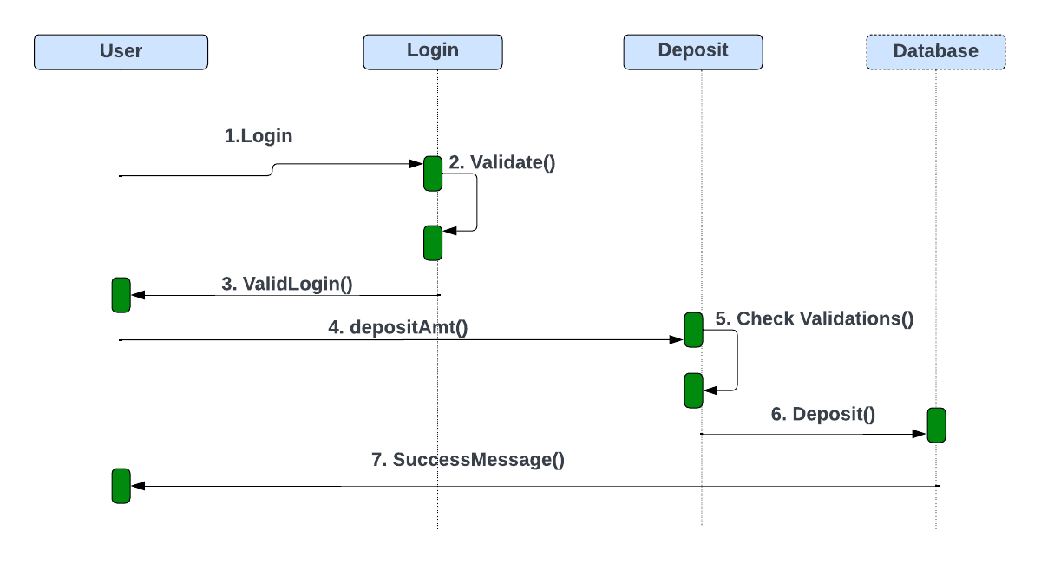
DEPOSIT SEQUENCE DIAGRAM

Slide 19
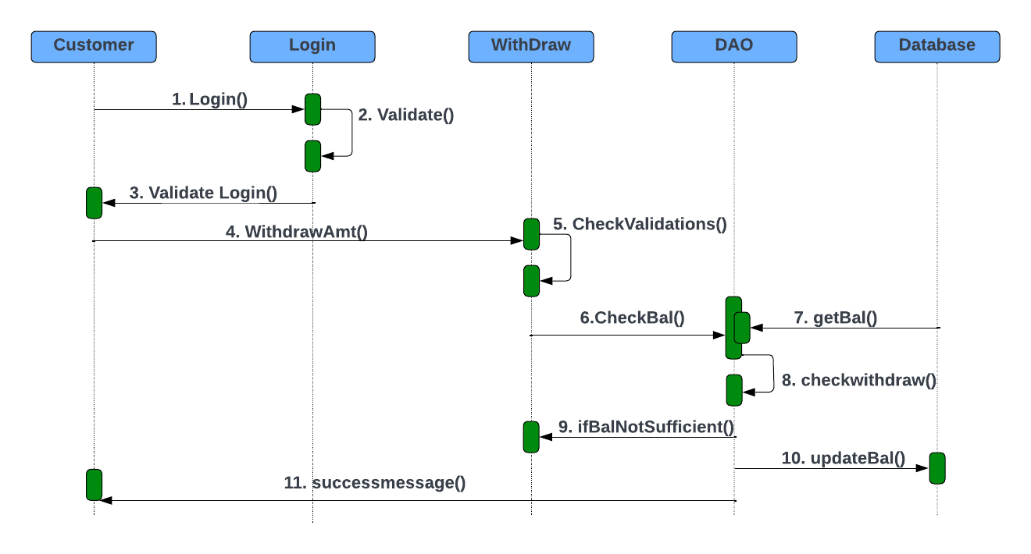
Withdraw Sequence Diagram

Slide 20
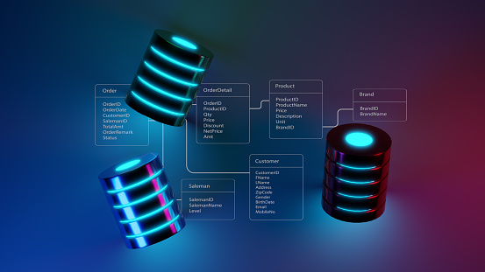
Database
Database : Online Banking
Tables:
1. admin
2. cheque_book
3. personal_transaction
4. primary_account
5. savings_account
6. transactions
7. user

Slide 21
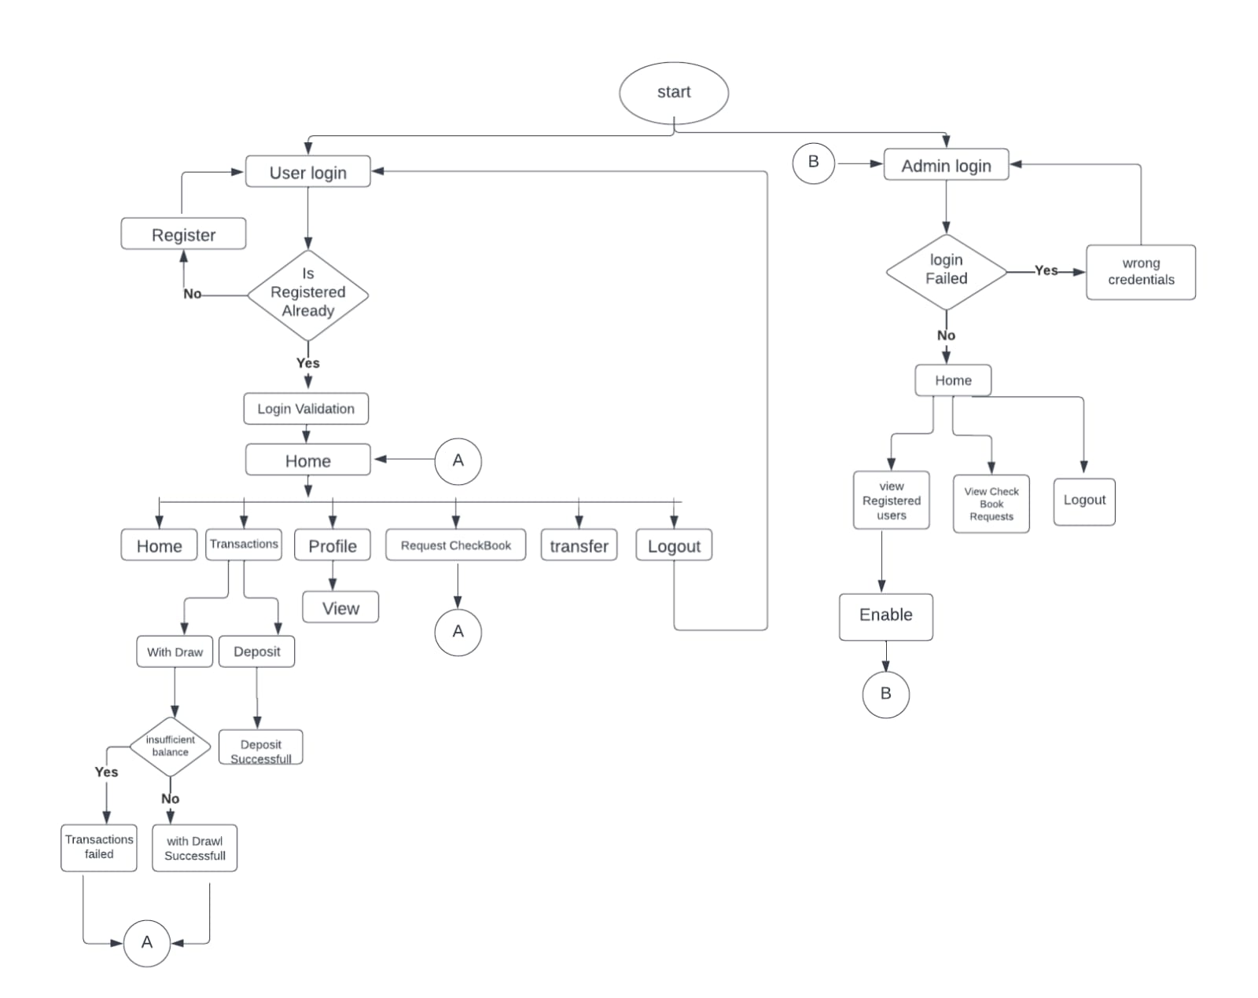
FLOW CHART

Slide 22
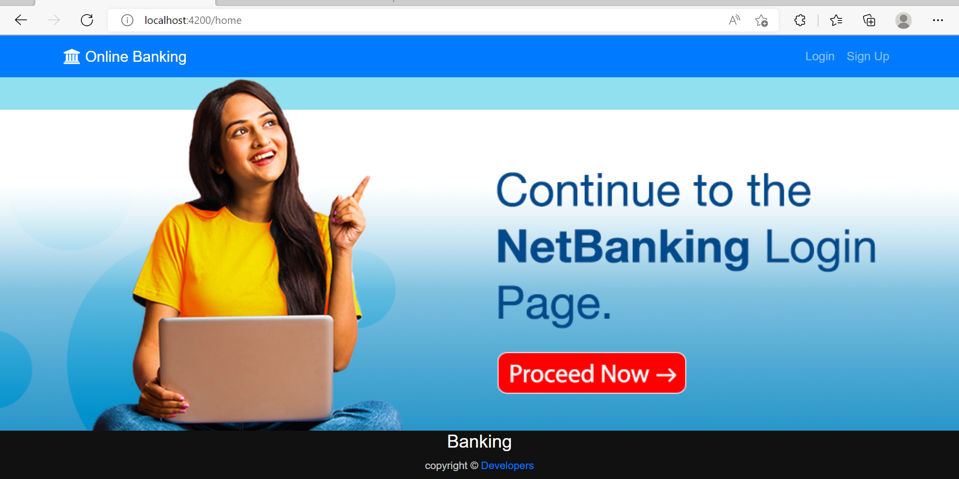
Output : HOME PAGE

Slide 23
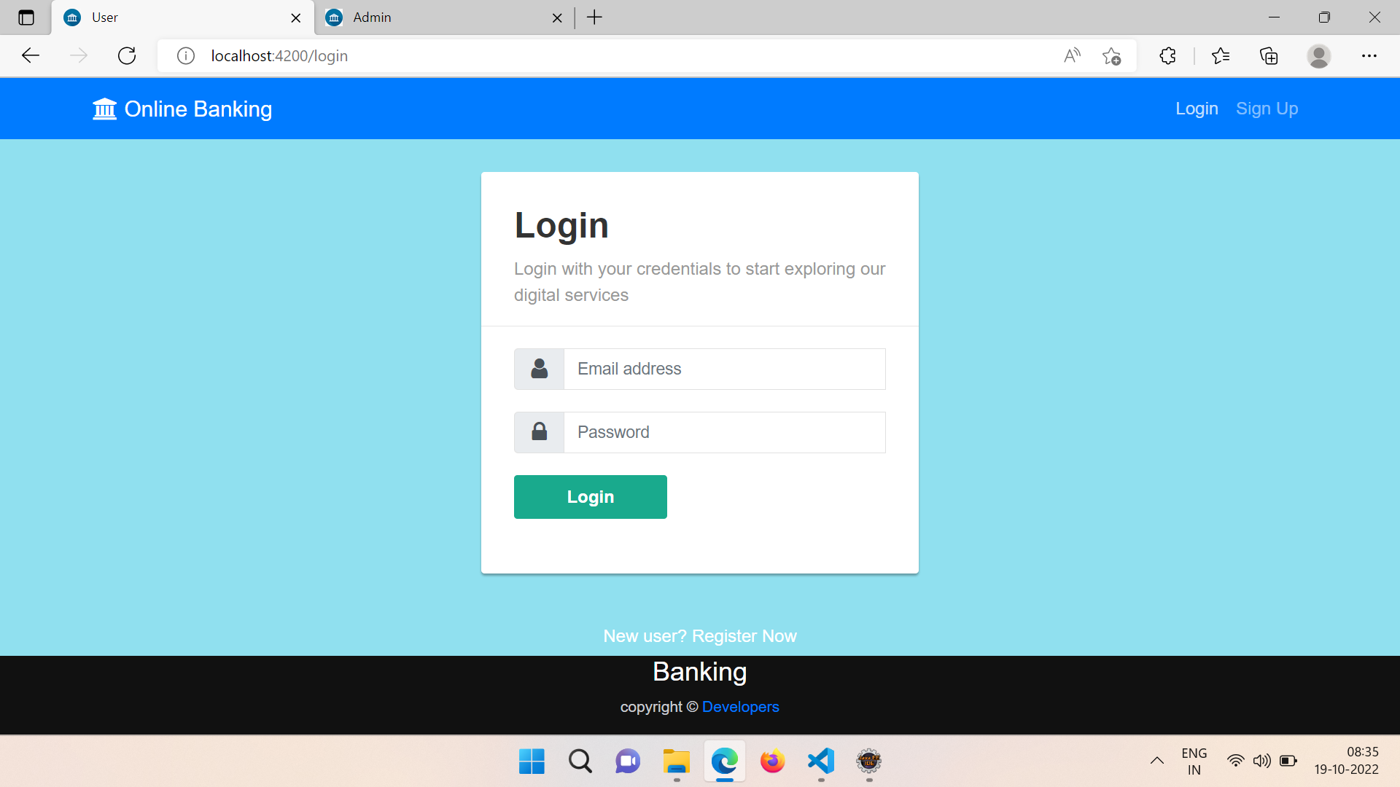
USER LOGIN:

Slide 24
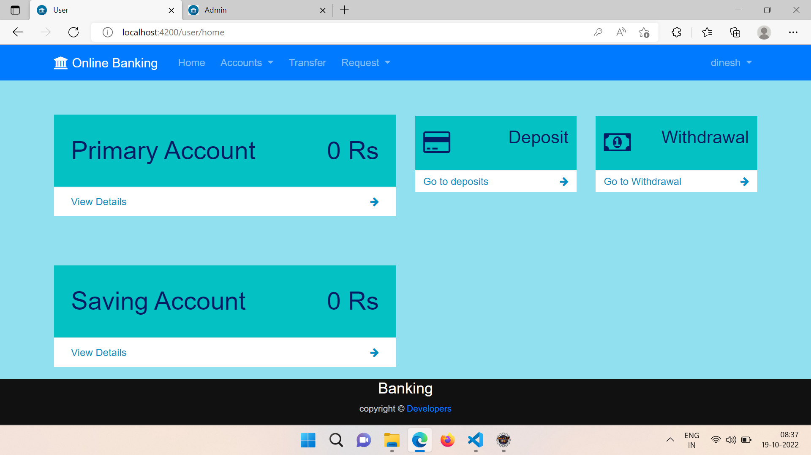
USER DASHBOARD:

Slide 25
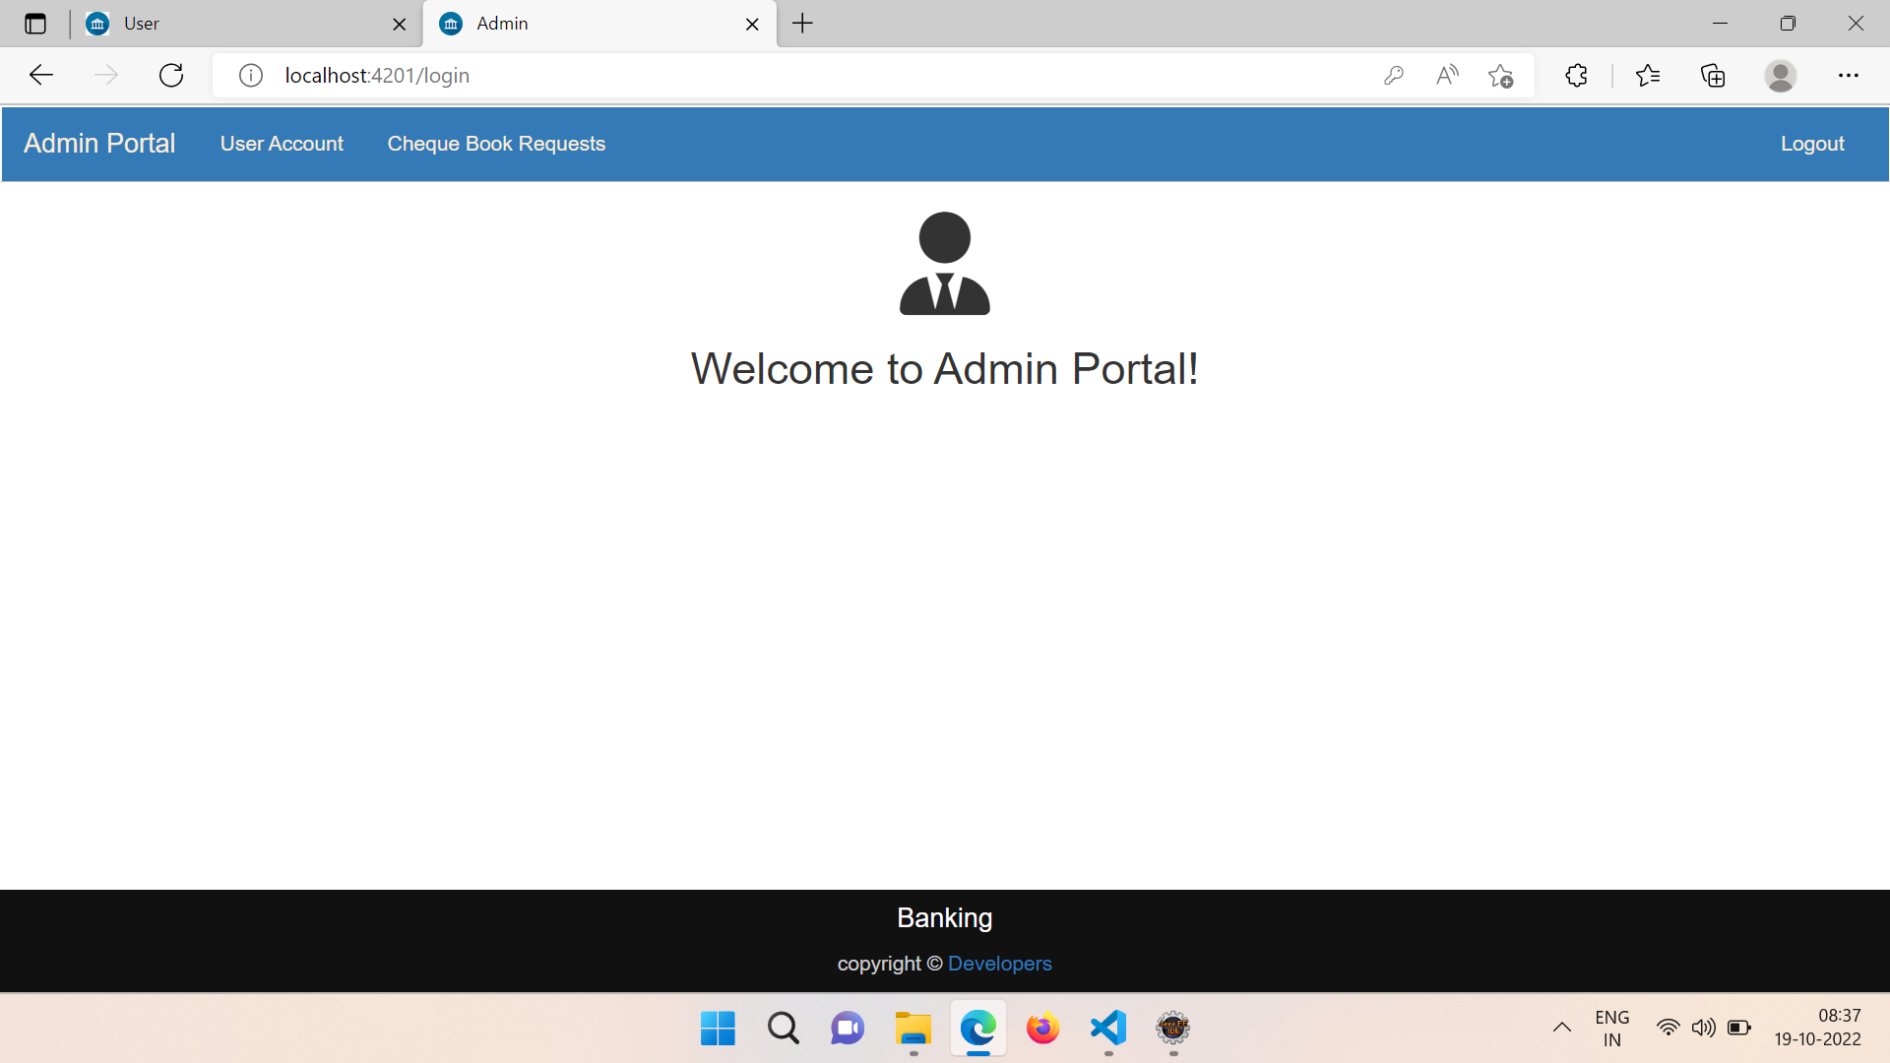
ADMIN DASHBOARD:

Slide 26
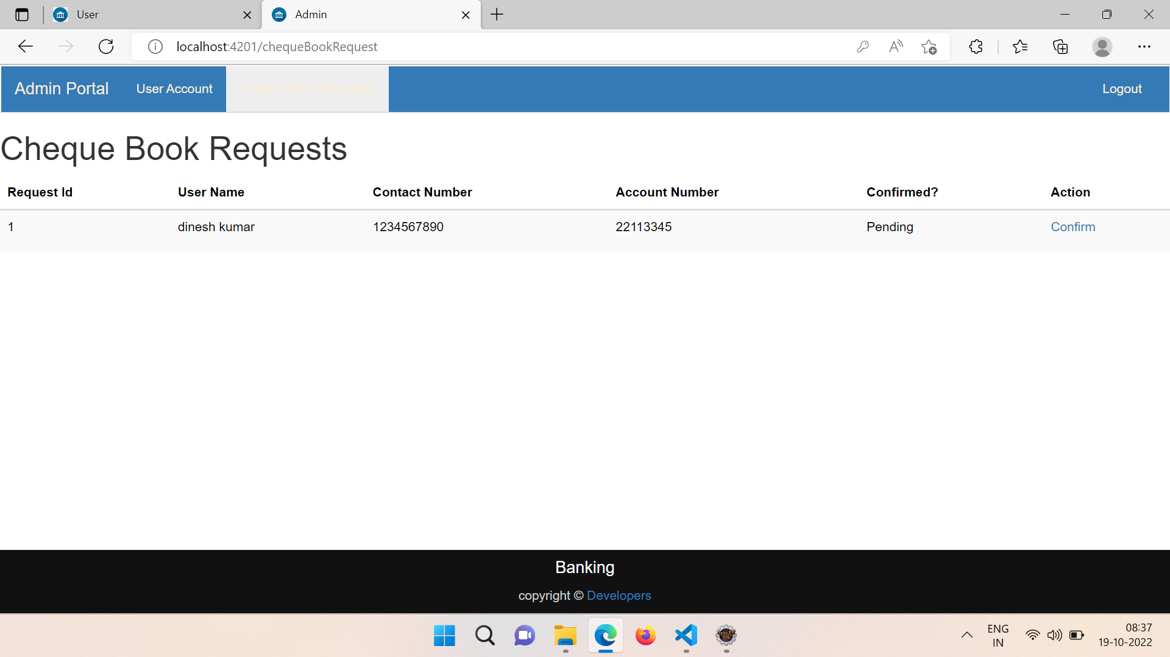
APPROVING CHEQUEBOOK REQUEST:

Slide 27

Testing
Testing is done with:
Functional testing
Selenium
Test NG
Functional testing:
Postman is an application that allows us to test APIs utilizing a graphical user interface. Some of Postman's advantages include the collection feature and the possibility to create different testing environments.
Selenium:
Selenium is an open-source tool that automates web browsers. It provides a single interface that lets you write test scripts in programming languages.
Test NG:
TestNG makes automated tests more structured, readable, maintainable and user-friendly.

Slide 28
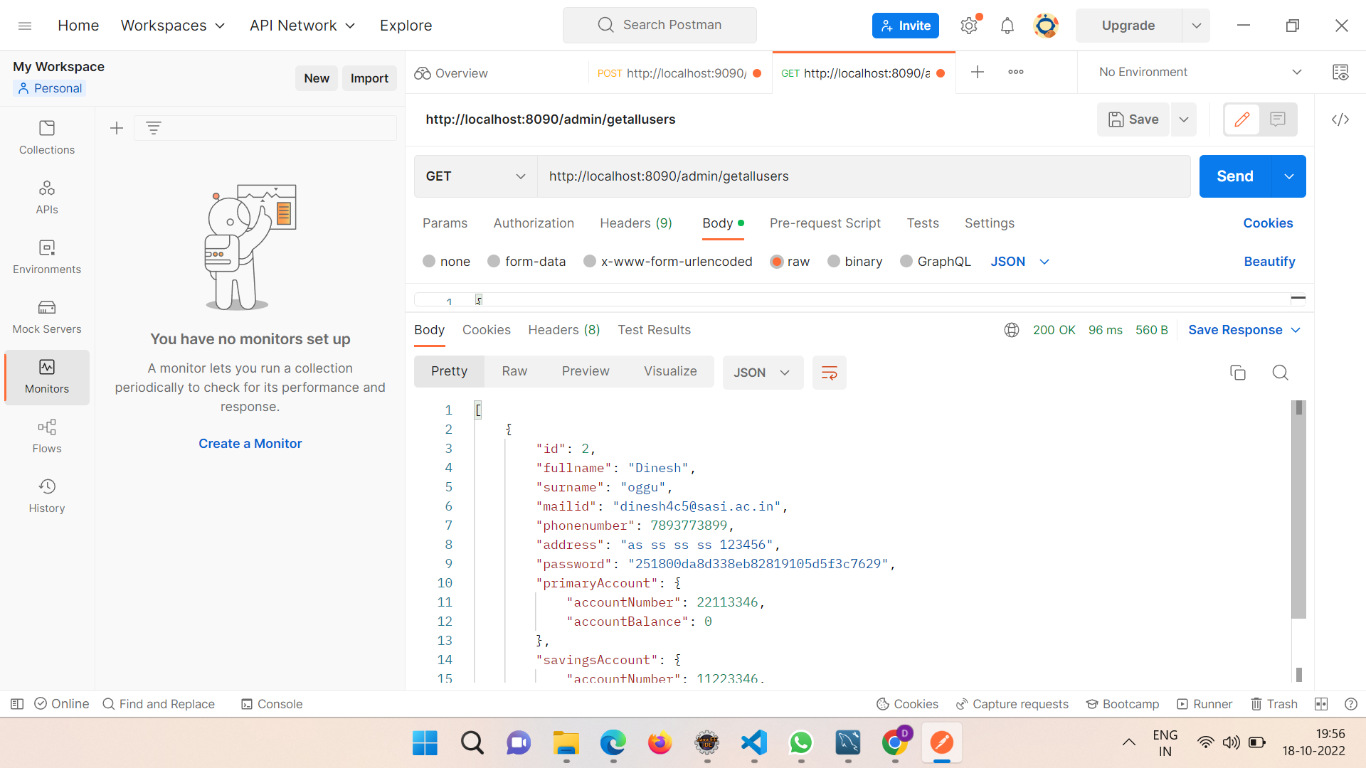
Testing - FUNCTIONAL TESTING

Slide 29
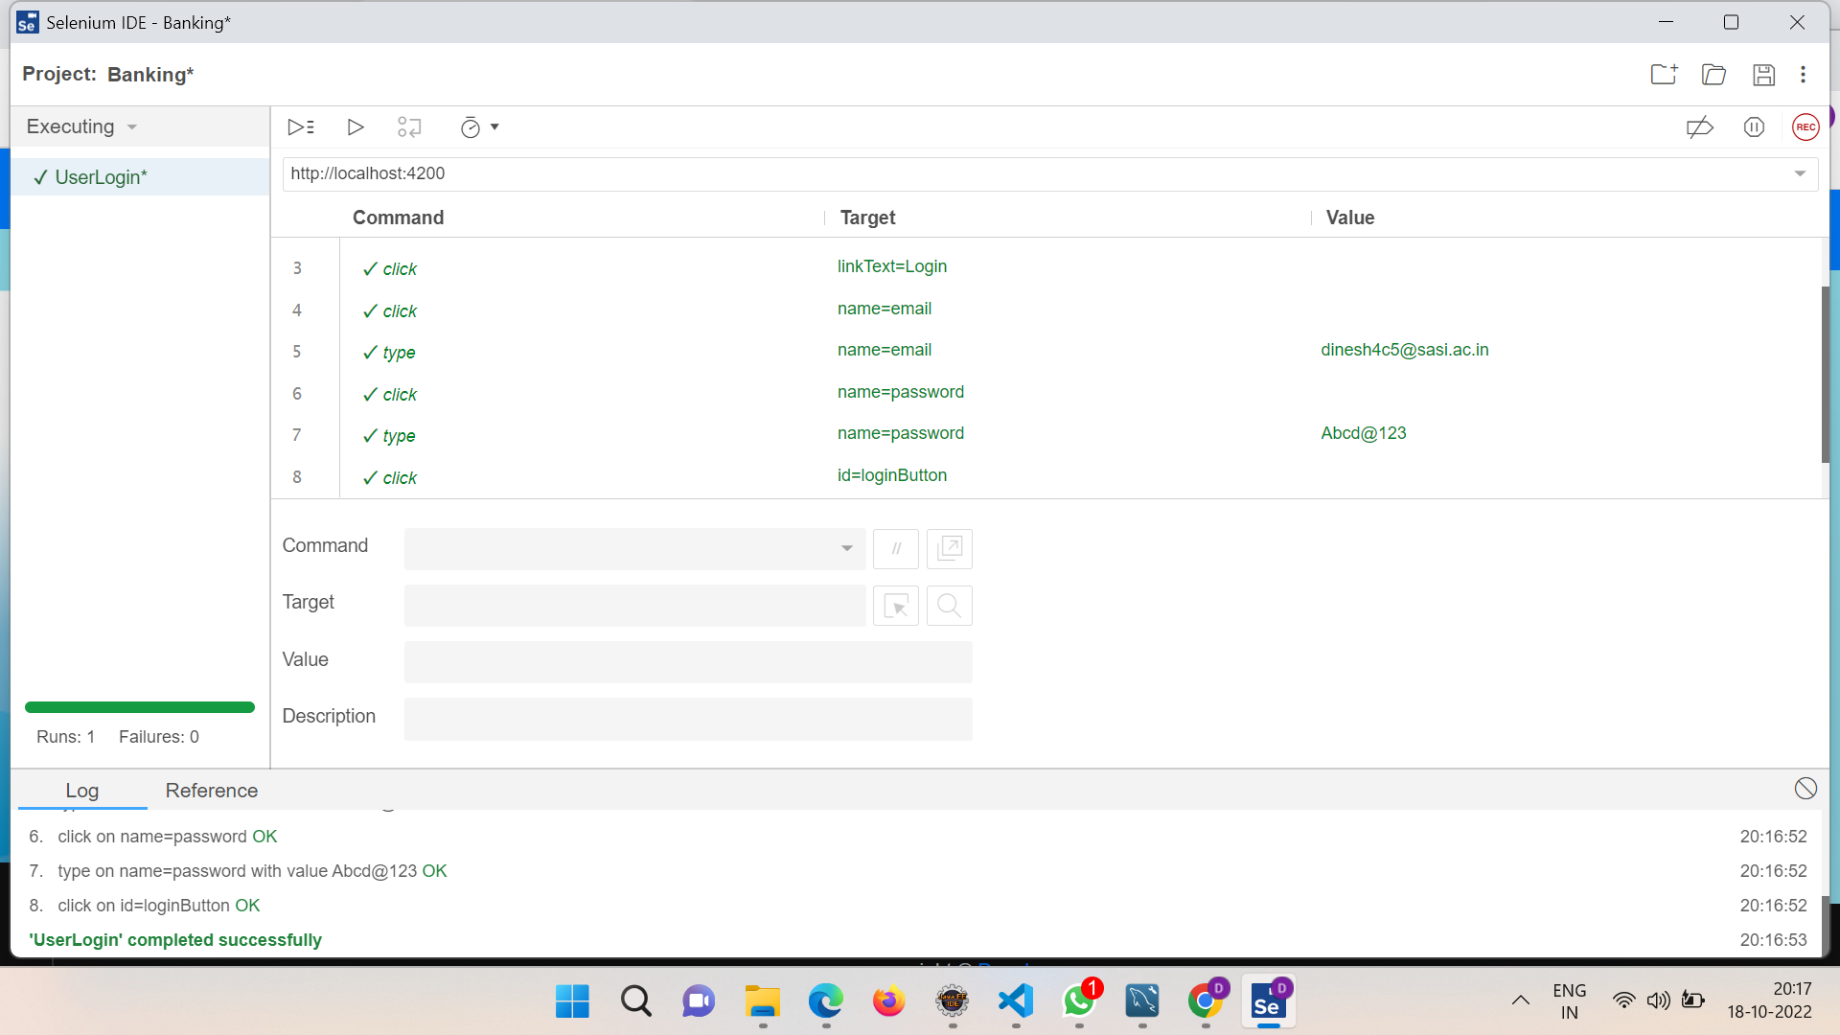
Testing – SELENIUM TESTING

Slide 30
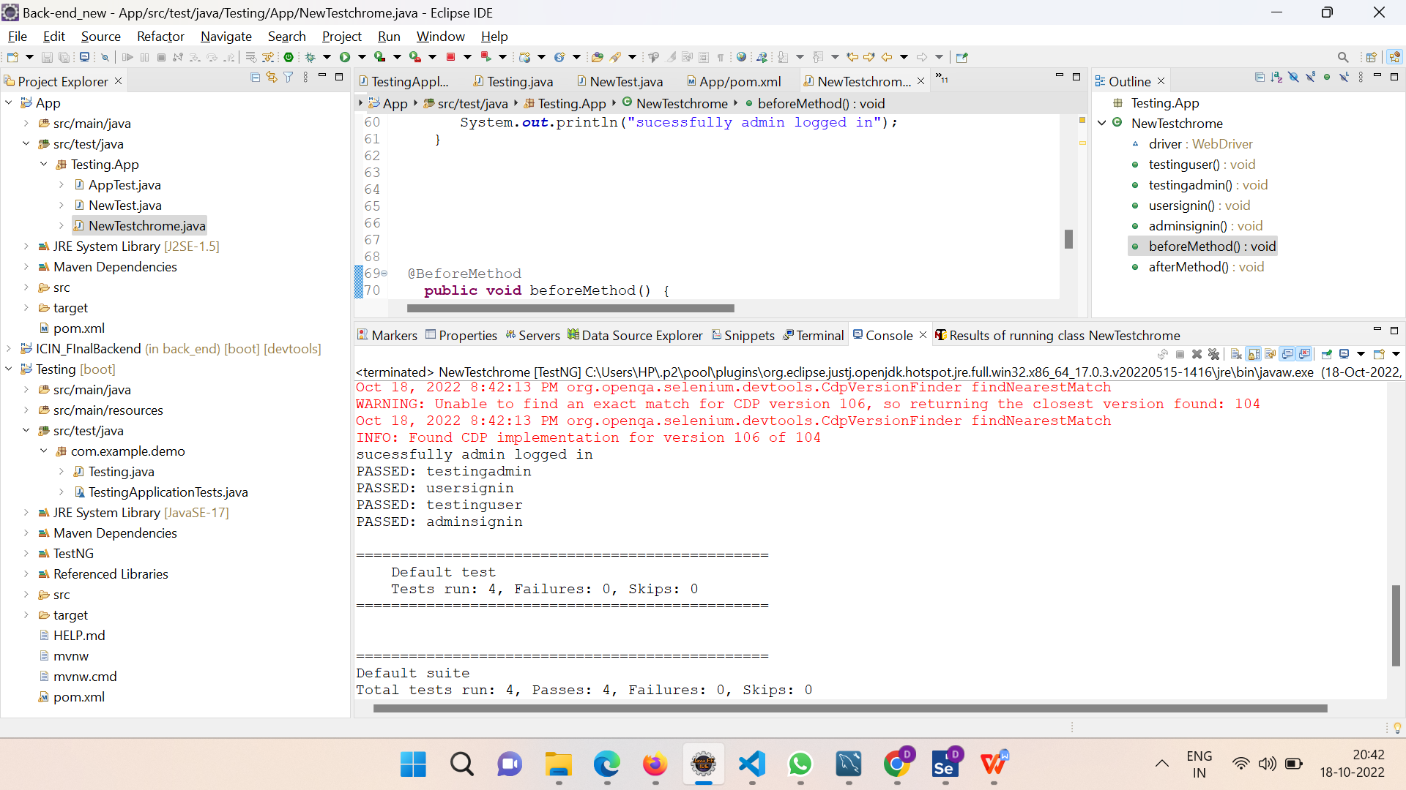
TESTING - TESTNG

Slide 31
Conclusion
The “OnlineBanking” was successfully designed and is tested for accuracy and quality.
During this project we have accomplished all the objectives and this project meets the needs of the organization.
The developed will be used in searching, retrieving and generating information for the concerned requests.

Slide 32

GOALS
Reduced entry work.
Easy retrieval of information.
Reduced errors due to human intervention.
User friendly screens to enter the data.
Portable and Flexible for further enhancement
Fast finding of requested information.

Slide 33


